Slide 1

Manual Testing Project
Welcome to our manual testing project! In this project, we applied all the theoretical knowledge we had gained to a real-world scenario. We worked in teams to simulate a complete software testing lifecycle, from requirements analysis to final test summary.
By
Majd Abu Hassanein
Hazem Lababidi
Ehab Halabi
Ahmad Abdallatif
Hanna Farhoud

Slide 2

The project was about testing an HRM system – Human Resource Management. This system manages employee information, attendance, leaves, payroll, and other HR-related tasks.
The system offers two access levels: Employee (ESS) Admin (HR Manager)

Slide 3
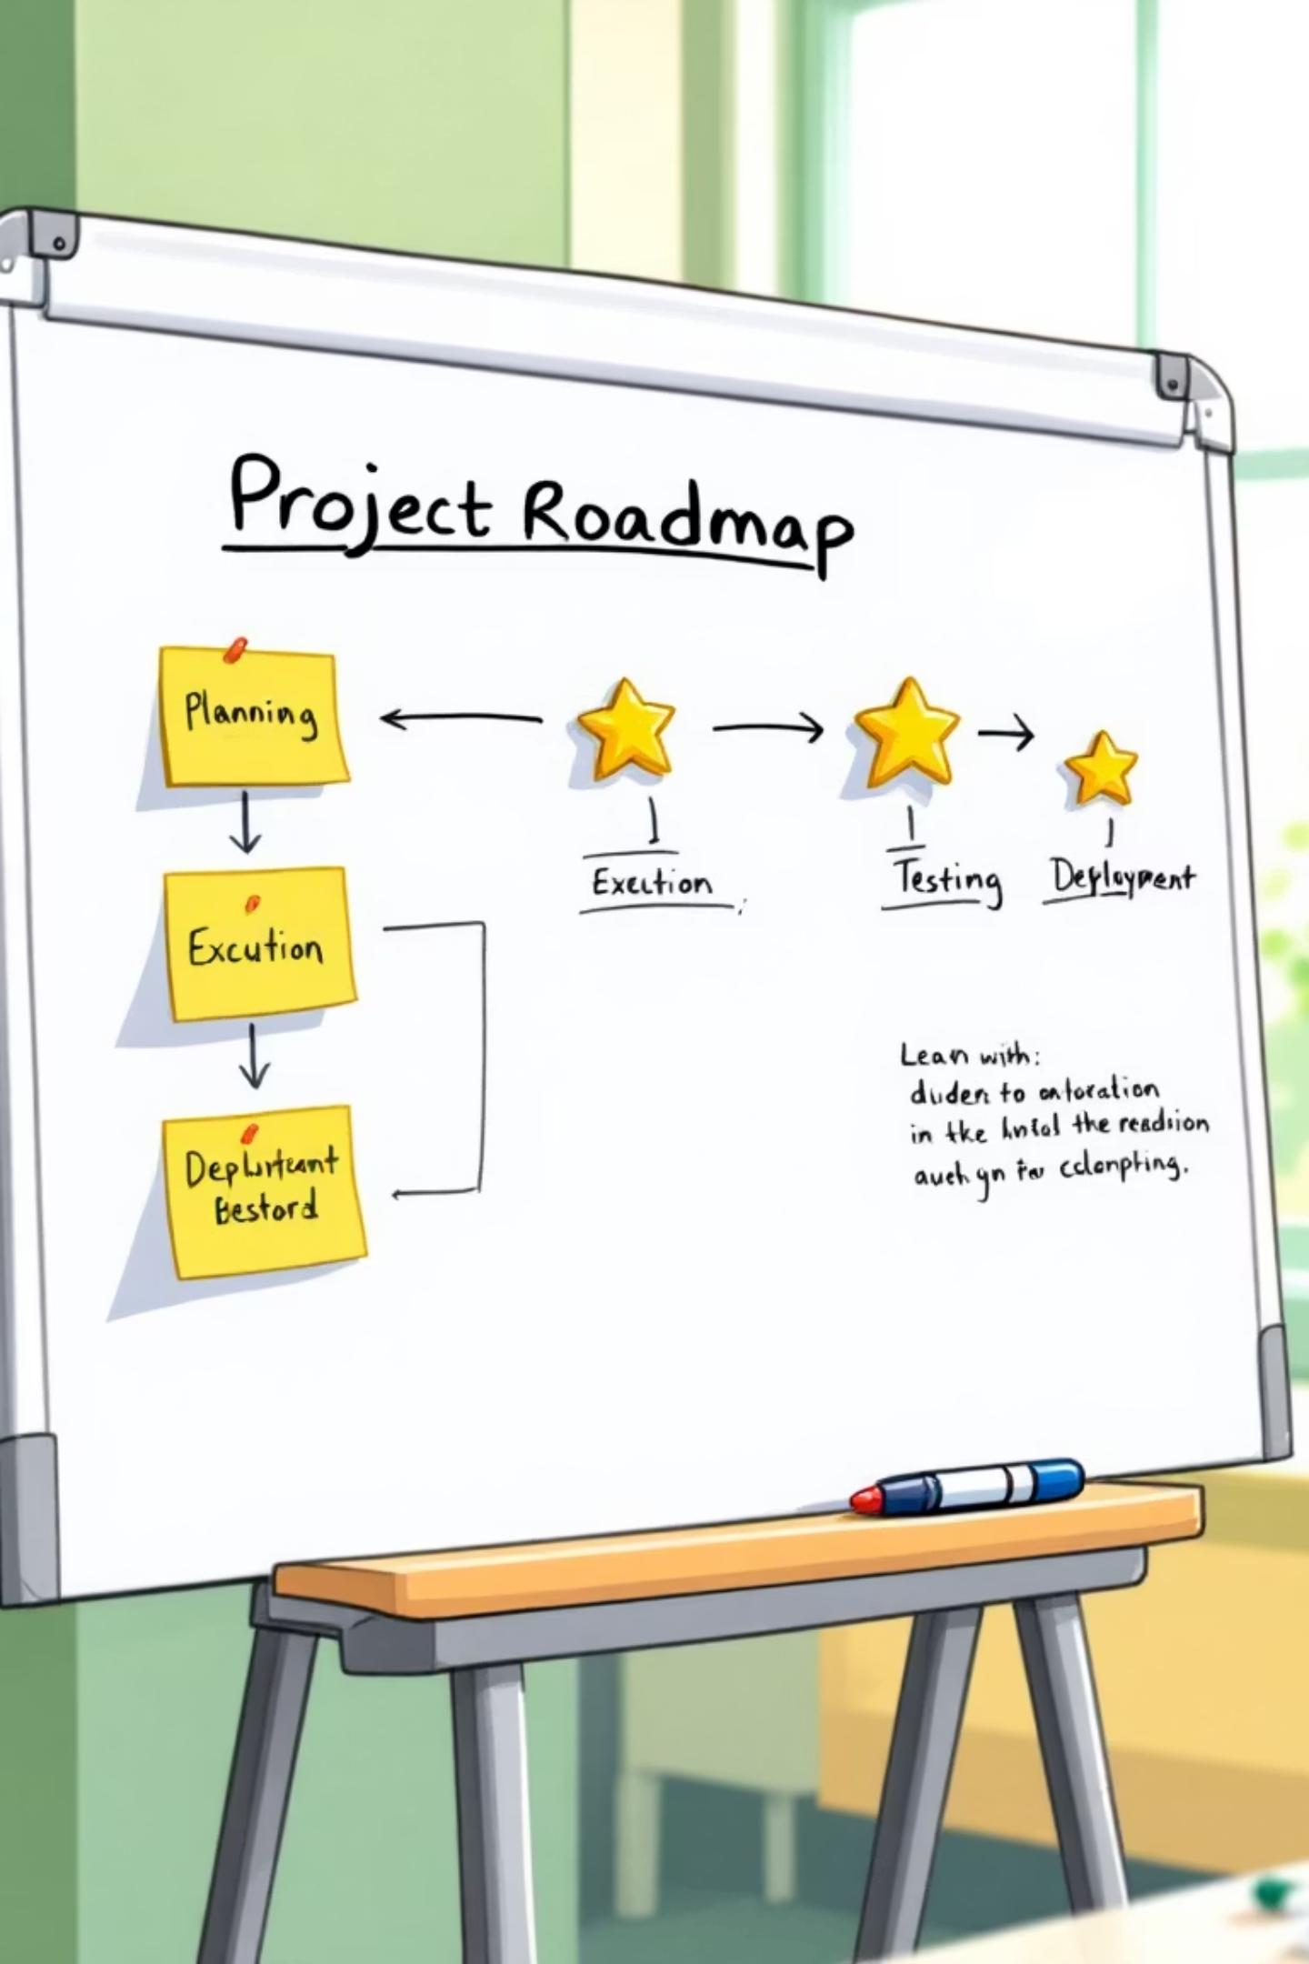
Project Overview: OrangeHRM Functional Testing
Project Assignment
The company had secured a new project, and our team was entrusted with all testing activities. This involves a comprehensive functional testing initiative for the OrangeHRM system.
Team Structure
Our team of 5 members were divided into two groups: one focusing on the Admin Module and the other on the Employee Module, ensuring specialized and thorough coverage.
Test Methodology: Functional Testing
Our team conducted manual functional testing only. The focus was on verifying that the core functionalities of the system operate correctly according to the defined requirements. Non-functional testing was not performed as it was outside the defined scope of work.

Slide 4




Phase 1: Requirements Analysis & Setup
In this foundational phase, our QA team dived into understanding the OrangeHRM system's requirements. This involves detailed analysis to ensure all functionalities are captured for testing.
Create Trello Board
Define Board Lines
Module Specialization
Set up a new Trello board titled "OrangeHRM - Functional Testing" to manage the workflow. This board was central to tracking all our testing activities.
Established the essential columns for the workflow: TO DO, In Progress (for test case writing), Blocked, Testing, and Done. These lines provided a clear visual of our project's status.
Assigned team members to either the Admin Module or Employee Module groups, fostering specialized knowledge and efficient testing within each area.
Trello Board Link

Slide 5

Phase 2: Test Plan Development
With a clear understanding of the project scope from Phase 1, our QA teams embarked on creating a comprehensive test plan. This document will guide our entire testing process.
Craft the Test Plan
Developed a detailed test plan in PDF format. This plan should outline the scope, objectives, resources, schedule, and approach for testing OrangeHRM.
Test Plan Link
Break Down Requirements
Deconstructed the OrangeHRM system requirements into manageable tasks. Each task should clearly define a specific piece of functionality from the user's perspective.
Assign Task Cards
Assigned each task as a card on the Trello board. Distributed these cards among our team members, considering their module specialization (Admin or Employee).

Slide 6




Phase 3: Test Cases Design
This phase is crucial for ensuring thorough testing. Each team member was responsible for designing detailed and clear test cases for their assigned tasks.
Detailed & Clear Design
Utilize Provided Template
Each test case must be meticulously crafted, providing clear steps, expected results, and preconditions. Ambiguity should be avoided to ensure replicability and accuracy.
Adhere strictly to the provided Google Sheets template for all test case documentation. Consistency in format is essential for project organization.
Test Cases Link
Test Case Template Link
Module-Specific Cases
Ensured test cases align with the module specialization (Admin or Employee), covering all relevant functionalities within the assigned area.

Slide 7
Phase 4: Test Execution & Bug Reporting & RTM
This is where the designed test cases come to life. We executed each test case and meticulously recorded the outcomes, reporting any discrepancies as bugs.
Execution Process:
Required Submissions:
We executed each test case following the detailed steps outlined in the design.
Bug Report (PDF): For every bug identified, We created a detailed bug report. Include steps to reproduce, actual vs. expected results, and screenshots.
We marked the status of each test case as either 'Passed' or 'Failed' in the test case document.
Bug Report Link
Requirements Traceability Matrix (RTM): We submitted an RTM that maps all tested requirements to their corresponding test cases and any identified bugs.
If a test case fails, We thoroughly investigated the issue to confirm it's a bug.
RTM Link

Slide 8
Phase 5: Test Summary & Project Conclusion
The final phase involved compiling the findings into a comprehensive test summary report. This report highlighted the overall quality of the OrangeHRM system based on your testing efforts.
88%
12%
0%
Passed Tests
Failed Tests
Skipped Tests
Percentage of test cases successfully executed with expected results.
Percentage of test cases that revealed defects or did not meet expected outcomes.
Percentage of test cases that were not executed due to dependencies or blockers.
The test summary report should provide an overview of the testing activities, key metrics, and an assessment of the product's quality readiness. The design of this report was flexible, allowing us to showcase our analytical and reporting skills.
Test Summary Report Link

